Slide 1
Neighborhood factors affecting Fuel Station sales
Nanduri Dinesh Kumar
07-12-2020

Slide 2
Business Idea
The idea of this project is to explore the neighborhoods of all fuel filling stations in Tirupati(City in India) using Foursquare to analyse how the presence of different neighborhoods affect the fuel sales of each fuel station. A machine learning model can be created with the help of which any future project proposals to setup a fuel station in Tirupati can have its yearly sales figures predicted based on the neighborhood it is being set up in.

Slide 3
Who would be interested
The target audience are the stakeholders, the fuel station dealers and Oil companies who with the help of this model can get an estimate of the return on their investments before starting the project.

Slide 4
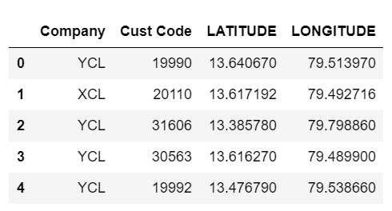
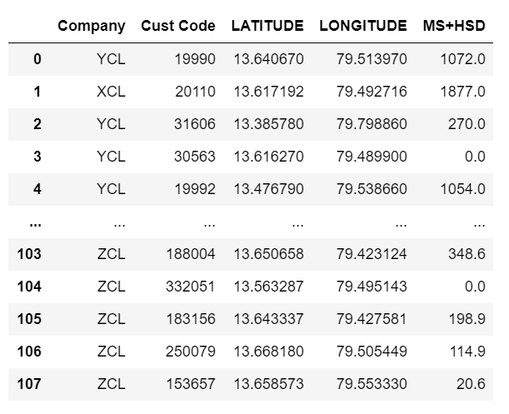
Data
List of fuel filling stations in Tirupati with their Name, Code, Latitude and Longitude
List of Fuel Filling stations with 2019-2020 Sales Figures in Kilo Liters

Slide 5
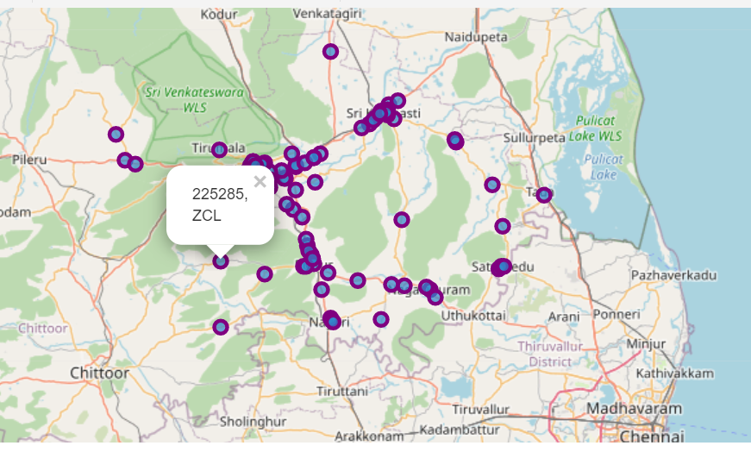
Plotting Fuel Stations on Tirupati map

Slide 6
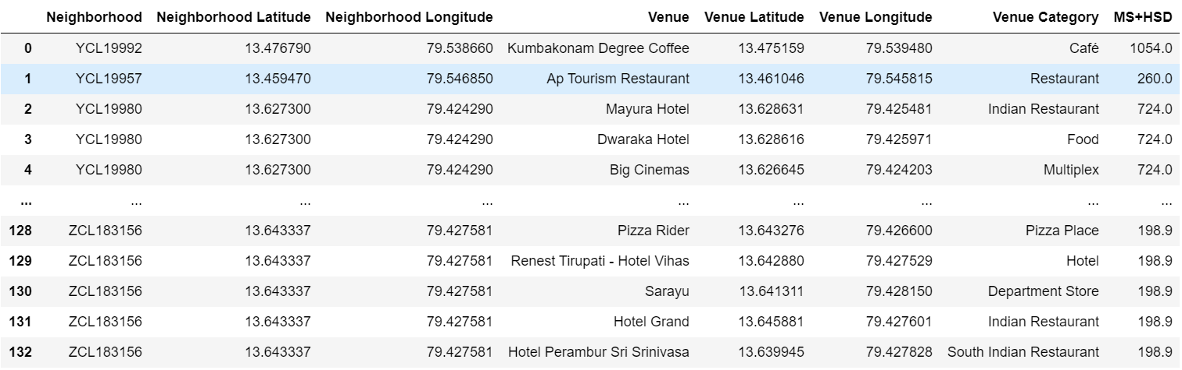
Finding Neighborhoods using Foursquare

Slide 7
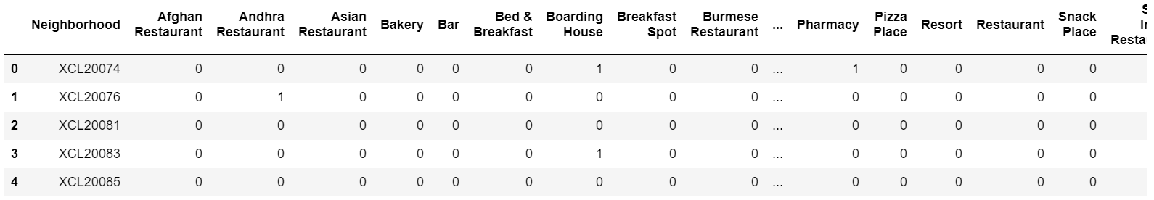
One-hot encoding and frequency mapping

Slide 8
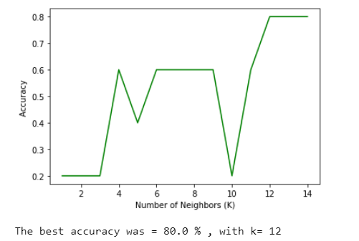
Machine Learning Model
K Nearest Neighbor algorithm

Slide 9
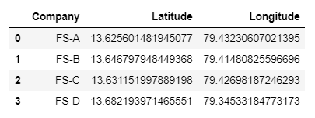
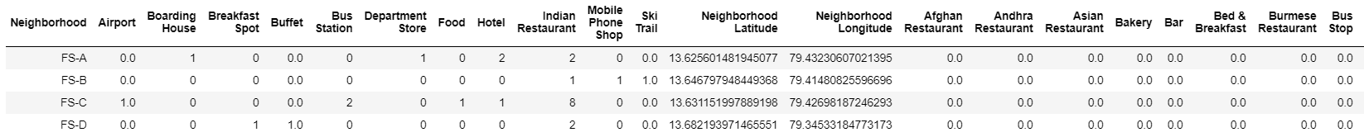
New Dataset

Slide 10
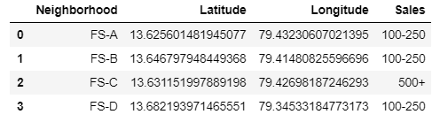
Results

Slide 11
Discussion and Conclusion
Sales tend to be higher when a Fuel station is placed near Hotels, Boarding houses since they invite more tourists and vehicles.
For Low sale Fuel Stations, the neighborhoods are venues with low footprint like- Jewelry store, Small cafes/ice cream shops, Gym, Local Business services, where people usually prefer to walk rather than travelling in a vehicle.
Model can be further improved and refined with more factors like the traffic congestion of roads near the Fuel stations and facilities available at each fuel station like - Car cleaning, Washrooms, Air pumps etc
A good use of data science and predictive analysis which can play a major role in decision making on an investment.

Slide 12
Thank You

